Slide 1
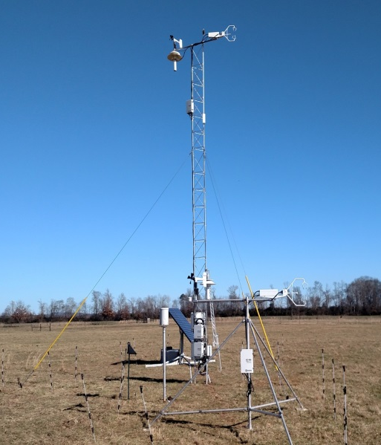
Boundary Layer Measurements
C. Bruce Baker, Director
NOAA/OAR/ARL/ATDD
June 21, 2016

Slide 2
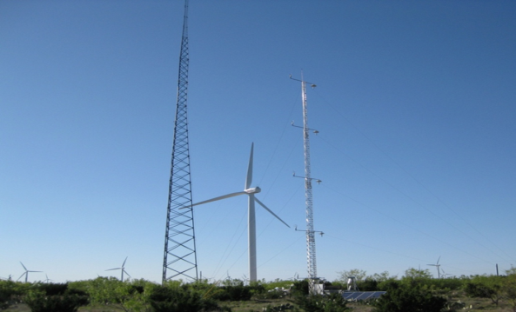
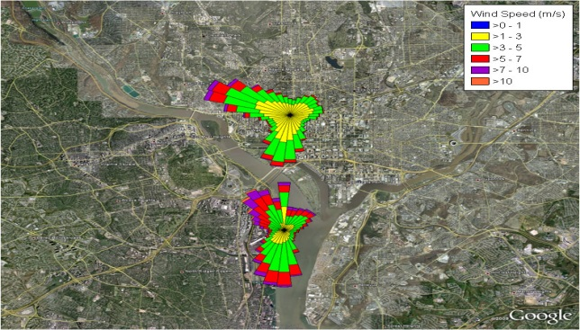
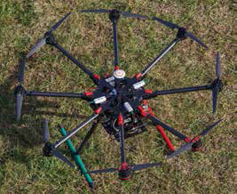
Relevance Using state-of-the-art methods and techniques to better understand atmospheric boundary layer structure and processes in order to improve prediction of near-surface weather and climate conditions.
Performance
Identify critical surface and boundary layer processes
associated with Convective Initiation and Tornadogenesis
Utilizing small unmanned aircraft systems (sUAS) for
Boundary layer profiling
Wind energy forecasting
Urban mesonets and boundary layer

Slide 3
Observational Gap and NOAA’s Mission – Quality Observations
Improved Observations hold the key to saving lives and property, and conserving
and protecting our natural resources
One of ARL’s goals is providing scientifically credible measurements to
support NOAA’s mission. This is includes QUALITY observations to
improve our understanding of forecasting severe weather, climate
variability and improving wind energy forecasts with observations
in the lowest part of the planetary boundary layer (PBL).

Slide 4
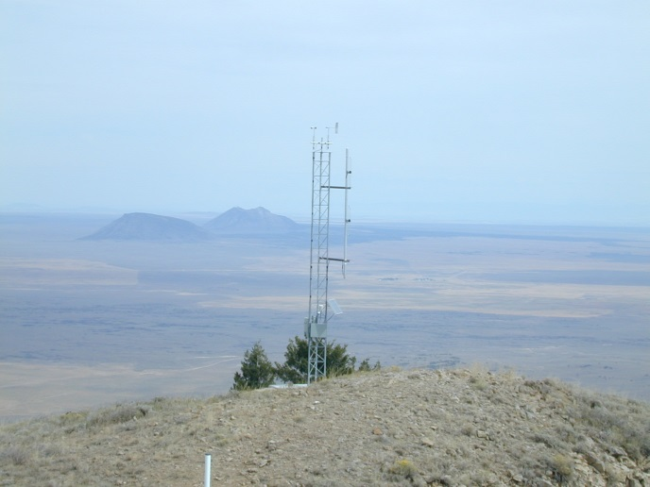
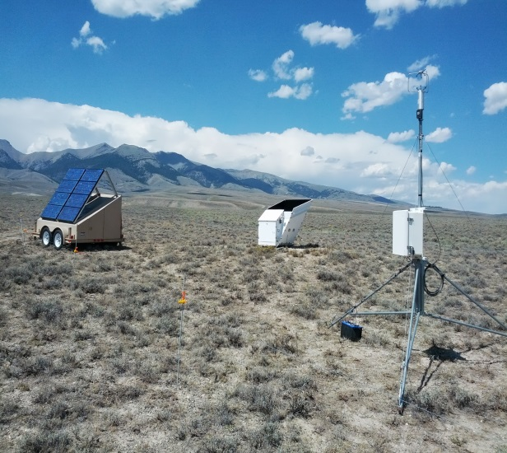
Complex Terrain
Background
High-resolution wind and PBL observations in complex terrain to test wind models used for wildfire spread predictions
Collaboration with U.S. Forest Service and Washington State University
Approaches
Field studies over isolated mountain (Big Southern Butte) and tributary canyon (Birch Creek) in Idaho
High-density wind observations in terrain together with vertical profiling systems
Relevance
Improved models for wildfire spread.
Protection of life and property
3 research publications
Potential applications to dispersion and wind energy in complex terrain
Big Southern Butte
Birch Creek Valley

Slide 5
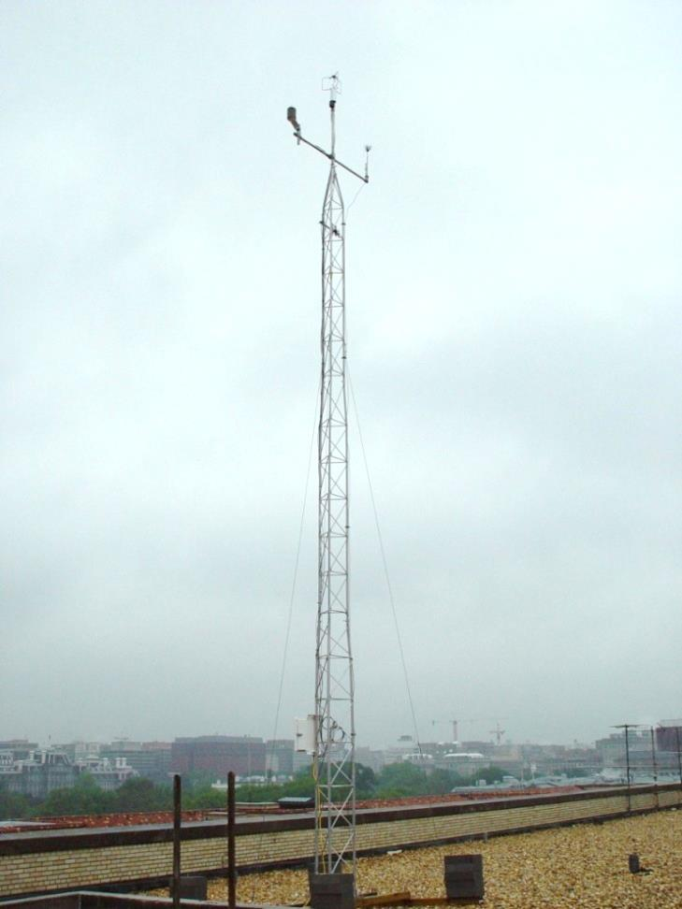
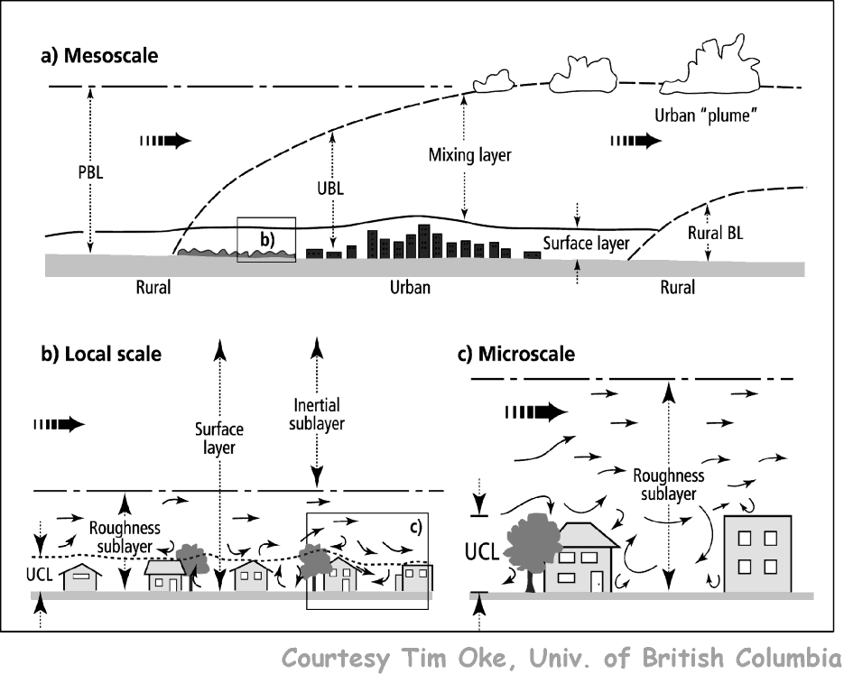
DCNet
DCNet is a NOAA dispersion forecasting program,
intended (a) to determine how best to make use
of local data in order to derive an acceptably
accurate product and (b) to provide DC with the
best possible dispersion forecasting system.
Notes:
“A weather-ready nation is a society that is able to prepare for and respond to environmental events that affect safety, health, the environment, economy, and homeland security. Urbanization and a growing population increasingly put people and businesses at greater risk to the impacts of weather, water, and climate-related hazards …” NOAA’s Next-Generation Strategic Plan, 2010
Poster
The DCNet is a ARL research meteorological monitoring network designed as a prototype urban testbed. The urban monitoring system was proposed in 2003 in response to a data call from NOAA concerning meteorological aspects of the events of September 11th. The questions asked were simply “how many?”and “where to install?” urban meteorological monitoring stations, in order to provide first responders with accurate, timely, and appropriate transport and dispersion information. The first DCNet stations (Herbert Hoover DOC Building, National Academy of Sciences, NOAA SSMC#3, and Navy Annex) were installed in the fall of 2003. This slide contains a photograph of the first DCNet station located on the roof of the Department of Commerce (HCHB).
At its peak, there were 17 DCNet meteorological observation sites operating within the National Capital Region (NCR). As part of the urban testbed program, ATDD operated two DCNet style stations in New York City (Times Squares and Manhattan) for five years before transferring the New York stations to the Department of Homeland Security.
Currently the DCNet monitoring system has been reduced to 7 stations operating within central metro area.
On the Drag and Heat of Washington, DC, and New York City
Author(s): Hicks, Bruce B.; Pendergrass, William R., III; Vogel, Christoph A.; et al.
Source: Journal of Applied Meteorology and Climatology Volume: 53 Issue: 6 Pages: 1454-1470 Published: JUN 2014
DOI: 10.1175/JAMC-D-13-0154.1
Temporal and Spatial Aspects of Velocity Variance in the Urban Surface Roughness Layer
Author(s): Hicks, Bruce B.; Novakovskaia, Elena; Dobosy, Ronald J.; et al.
Source: Journal of Applied Meteorology and Climatology Volume: 52 Issue: 3 Pages: 668-681 Published: MAR 2013
DOI: 10.1175/JAMC-D-11-0266.1
Title: Urban Turbulence in Space and in Time
Author(s): Hicks, Bruce B.; Callahan, William J.; Pendergrass, William R., III; et al.
Source: Journal of Applied Meteorology and Climatology Volume: 51 Issue: 2 Pages: 205-218 Published: FEB 2012
DOI: 10.1175/JAMC-D-11-015.1

Slide 6
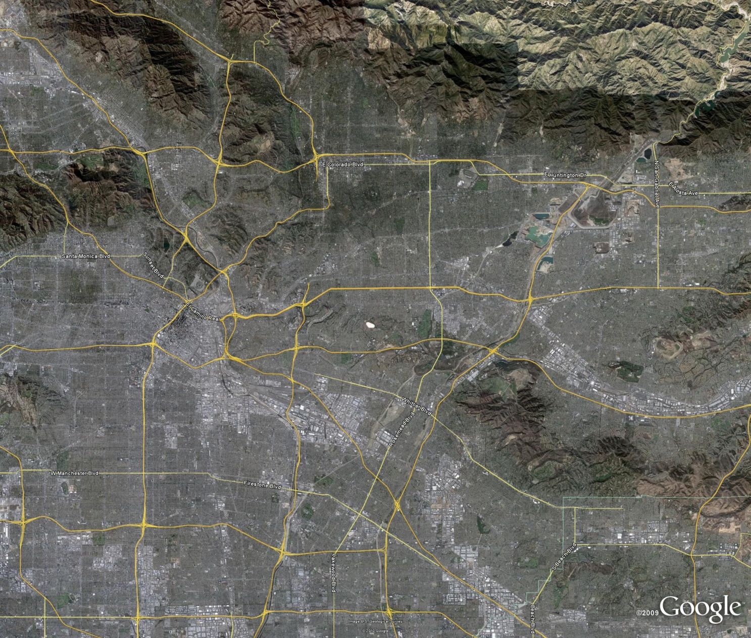
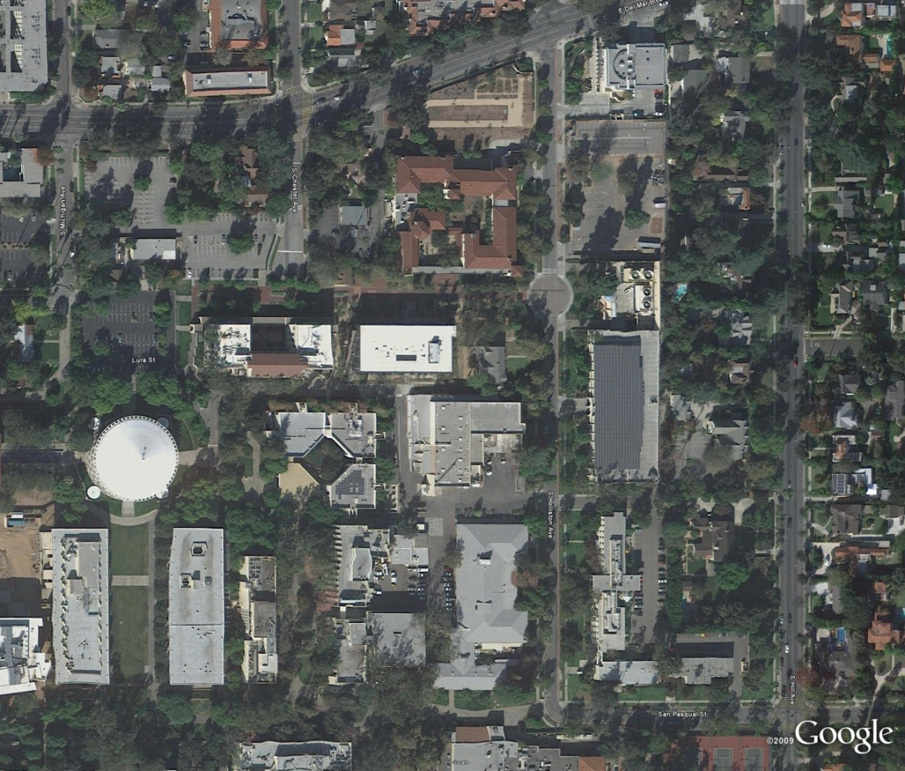
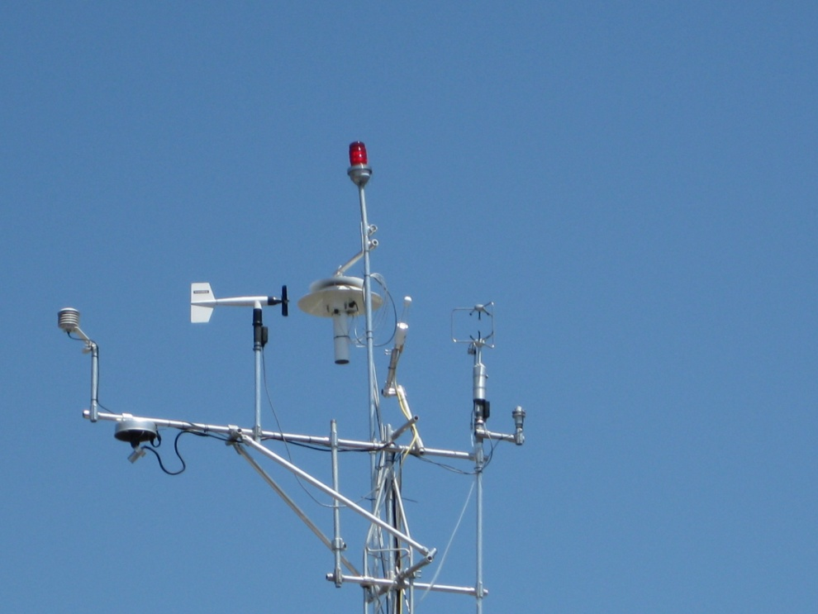
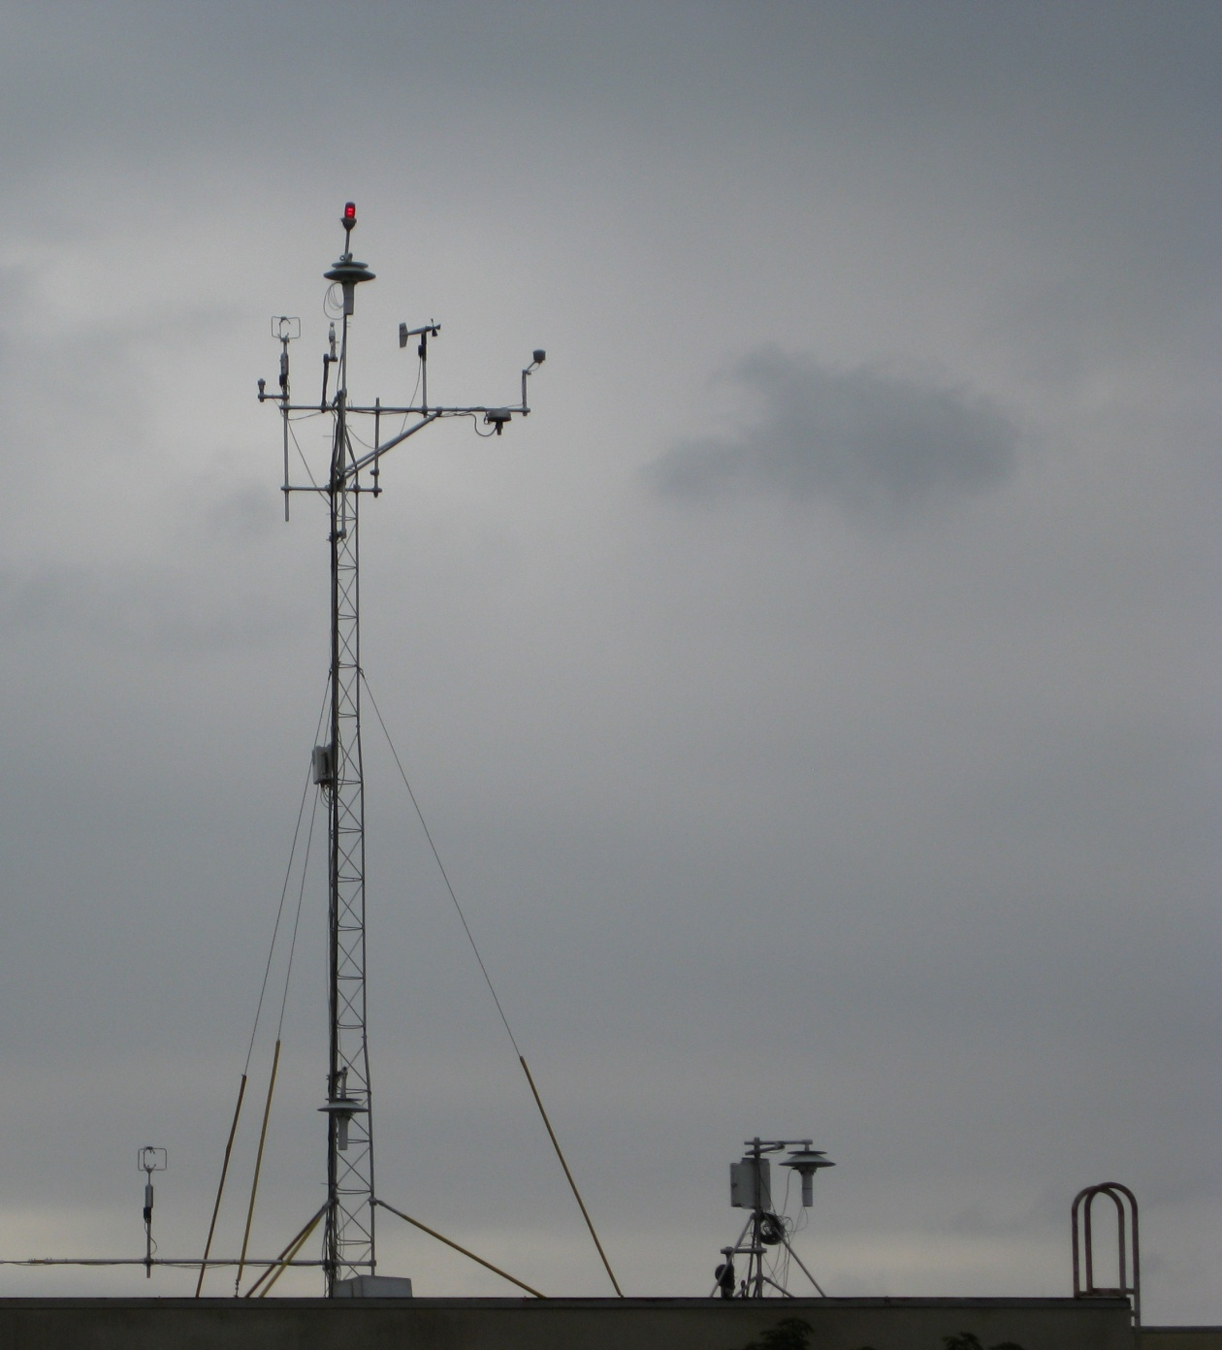
CalNex
2010
Pasadena, CA
Notes:
2010 CalNex Science Questions
Atmospheric Transport and Meteorology
Goal: Improved Urban Canopy Layer Parameterizations
(1) What are proper oceanic boundary conditions for coastal and regional atmospheric chemistry modeling? What physical and chemical changes occur as a parcel of air moves from off-shore, through the shore zone, and inland?
(2) How best can we characterize and model air flow over coastal waters and the complex terrain of California?
(3) What are the major deficiencies in the representation of chemistry and meteorology in research and operational models and how can models be improved through the collection of additional measurements? What physical and chemical processes are not captured well by available models? Is there an optimum grid resolution to capture all of the relevant physical and chemical processes that occur?
Participation in CALNEX 2010 provided an opportunity to extend observations and findings from the Washington, DC DCNet metro study to a second urban site. Bottom line for the comparison of Pasadena and DCNet measurements: quite similar environments. Continues the conclusions reached in Hicks and Pendergrass , 2014. For the most part, cities are cities as long as one can assume skimming flow based on the local urban topology. Surface fields within urban areas can be modeled as embedded highly three dimensional turbulent fields where as would be expected mechanical turbulence dominates.
ARL/ATDD 2010 participation in CALNEX. Increase our understanding air quality and air-surface exchange in urban environments. The relationship of energy exchange measured in Urban areas is not well understood, and is complicated by the differences in flux footprint between the two locations and urban surface heterogeneity. ARL/ATDD will develop a data set of variables critical to understanding and modeling air quality and air-surface exchange over an urban canopy.

Slide 7
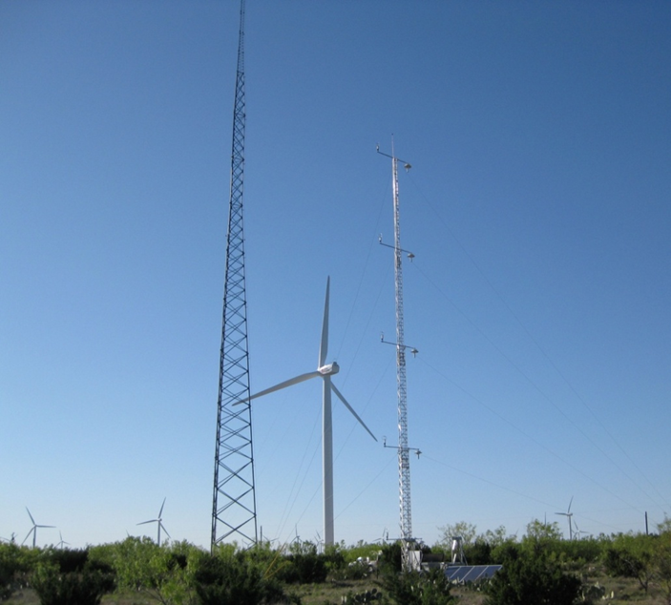
NOAA/ARL-Duke Energy Generation Cooperative Research and Development Agreement
A Public-Private Research Partnership that supports NOAA’s mission and is relevant to the needs of users in industry.
Notes:
As an outcome of discussions between Duke Energy and NOAA/ATDD following the 2009 AMS Summer Community Meeting , August, 2009 in Norman Oklahoma, ARL and Duke Energy Generation (Duke) signed a Cooperative Research and Development Agreement (CRADA) which allowed ARL/ATDD to conduct atmospheric boundary layer (ABL) research using Duke Energy renewable energy sites as research testbeds. The proposed ARL research was directed towards evaluation of flux-gradient wind profile algorithms based on Monin-Obukhov (M-O) similarity theory to provide a more physics based forecast of hub-height winds. Duke Energy proposed evaluation of the proposed flux gradient algorithms within the scope of Duke’s current renewable energy load management practices and provide an assessment of the economic impact of any flux-gradient enhanced forecasts. While the design of this research was direct support for the renewable energy industry, the focus is on the same fundamental ABL atmospheric processes applied to a wide range of applications and environments.
For the NOAA/Duke Energy CRADA, ARL’s PBL research is focused on improved PBL parameterizations schemes through identification of representative input parameters for PBL modeling schemes as well as defining the level of uncertainty associated with the various techniques. ARL’s research within the scope of the NOAA/Duke Energy CRADA is aimed at four basic science questions:
(1) Can the prediction of wind turbine hub-height wind speeds be improved through inclusion of near-neutral and unstable flux-gradient wind modeling techniques?
(2) What is the uncertainty associated with high resolution WRF mesoscale in both now-cast and forecast of winds at 10m and hub-height?
(3) Does assimilation of surface energy flux measurements and parameterizations (heat flux, shear stress, surface roughness, displacement height, and mixed layer height) improve mesoscale forecasts through mesoscale model land surface exchange methodology or data assimilation?
(4) What is the impact of spatial variability in surface energy-balance on predicted gradient winds at 10m and hub-height?
The field research station was installed by ARL/ATDD in support of the NOAA/Duke CRADA , located on Duke Energy’s Ocotillo Wind Farm. The Ocotillo Wind Farm is located approximately 10 miles southeast of Big Spring, Texas. ARL/ATDD’s research tower is located at the southern limits of the Ocotillo property in close proximity to the Ocotillo PMM27-28 site 80m operational meteorological tower.
The outcome of the research has been the development of a site-specific probabilistic forecast based on NCEP’s NAM12 forecast product.
On the Micrometeorology of the Southern Great Plains 1: Legacy Relationships Revisited
Author(s): Hicks, B. B.; Pendergrass, W. R., III; Vogel, C. A.; et al.
Source: Boundary-Layer Meteorology Volume: 151 Issue: 3 Pages: 389-405 Published: JUN 2014
DOI: 10.1007/s10546-013-9902-2
On the Micrometeorology of the Southern Great Plains. 2: Turbulence Statistics
Author(s): Hicks, Bruce B.; Pendergrass, W. R., III; Vogel, C. A.; et al.
Source: Boundary-Layer Meteorology Volume: 154 Issue: 3 Pages: 351-366 Published: MAR 2015
DOI: 10.1007/s10546-014-9981-8

Slide 8
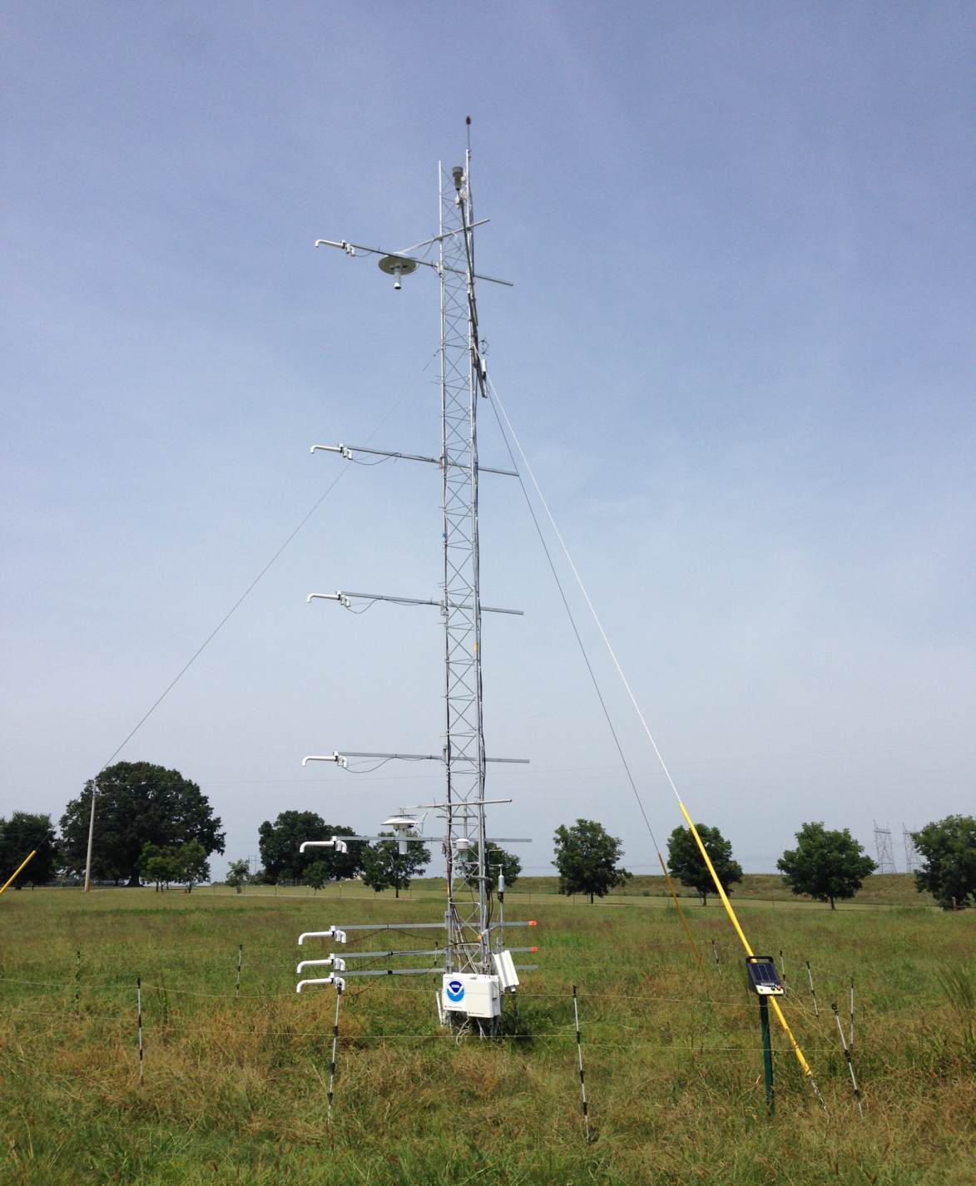
NOAA/ATDD
Surface-Layer Profiling
How well do Weather Research Forecast (WRF) model surface-layer algorithms simulate the atmospheric surface layer?
Notes:
The ATDD CI study offered an intensive field research measurement network to continue exploration of parameterization of the atmospheric surface-layer. In particular, the Belle Mina Research Station provided an opportunity to intensive instrument a tower in the lowest part of the atmospheric surface-layer. As shown in this photograph, eight precision aspirated thermocouples were deploy to measure the temperature profiles between 0.5 meters and 10 meters. The goal was resolution of the thermal roughness parameter z_{oT}. As implemented in Monin-Obukhov theory, the thermal roughness parameter is an important determinate if calculation of atmospheric stability. According to CHEN et al, 1977, modification of z_{oT} can lead to precipitation through changes in surface heating and modification to PBL heights.

Slide 9
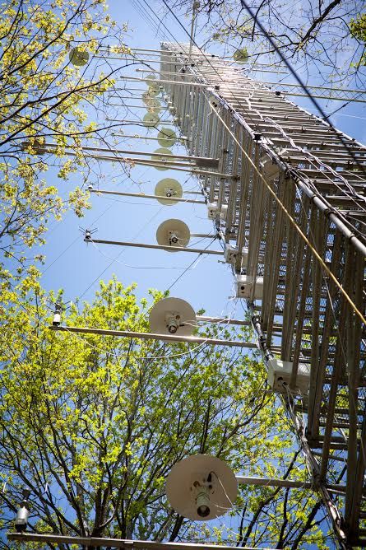
Chestnut
Ridge
Tower
Oak Ridge, TN
Notes:
ATDD Chestnut Ridge walk-up tower provides the extension of ATDD’s surface-layer research from the urban environment of DC to the desert southwest (Ocotillo) to the pastureland of Alabama to the typical forested environment of the US Southeast. Why the interest in forest canopies? Other than the specific environment addressed within the forest canopy, current urban canopy models are built on extension of parameterizations of the forest canopy. As mentioned in the discussion of ARL’s DCNet research, the surface-layer wind profile follows the velocity deficit model proposed by Garratt where the lower part of the velocity profile needs to account for the extension of the roughness sub-layer. Without this adjustment, standard models will over predict urban wind speeds.

Slide 10
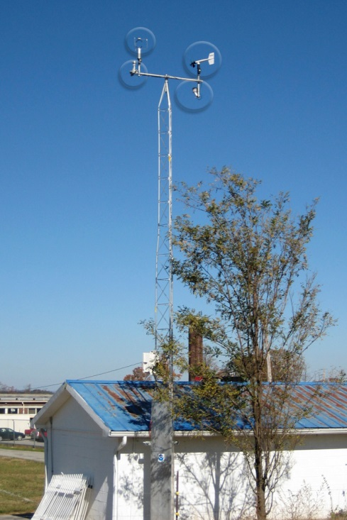
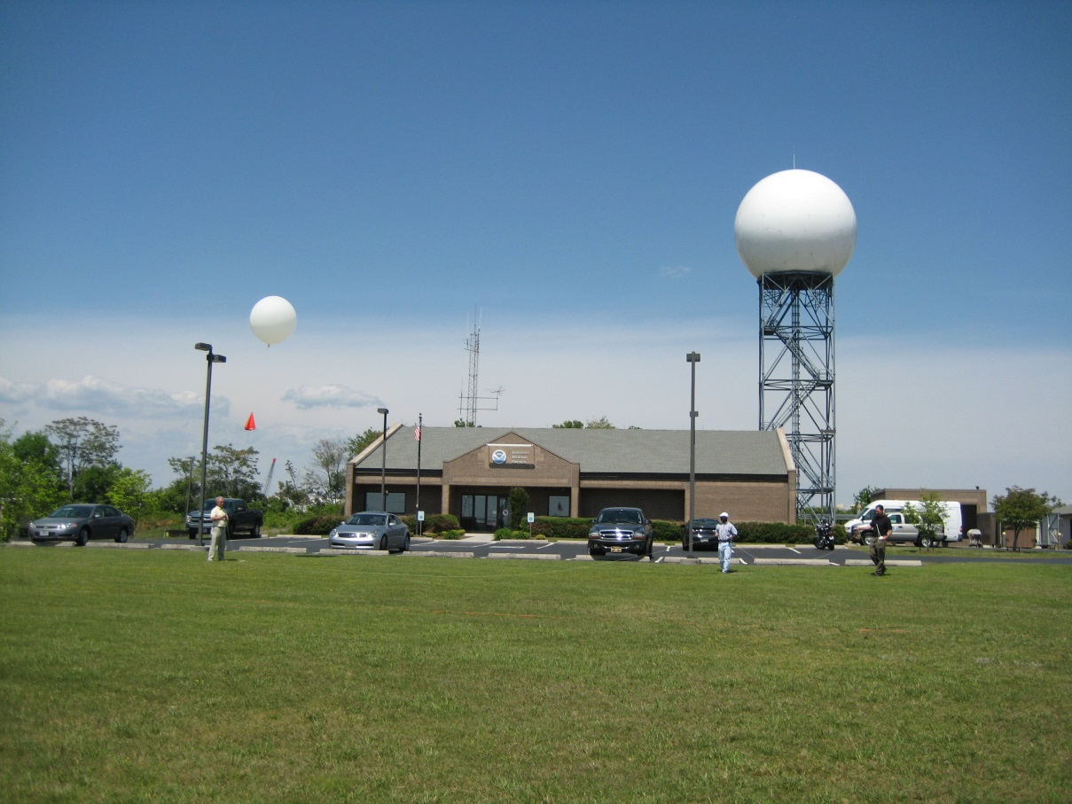
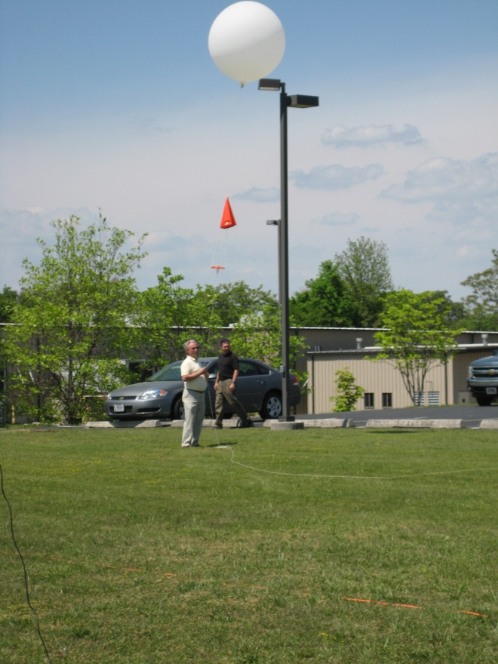
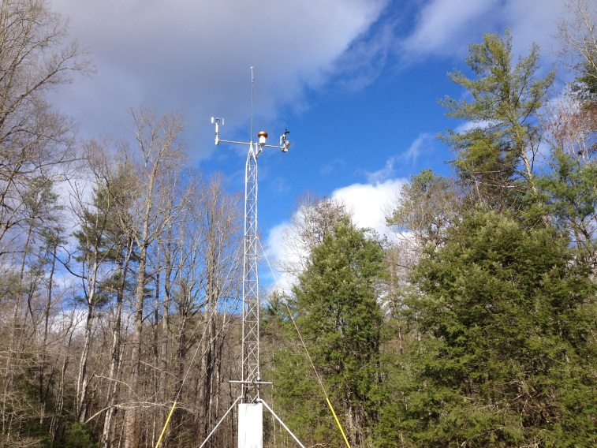
Camp Creek
Morristown WFO
Elkmont
Notes:
As part of ATDD’s outreach, ATDD has worked with local Federal Agencies to support studies focused on mesoscale meteorological phenomena associated with the ridge/valley structure of the East Tennessee Valley. Three examples are presented here.
(1) the meteorological tower install at the East Tennessee Camp Creek Elementary School supports the Morristown Weather Forecast Office high wind advisories associated with FOEHN or down-slope winds. Strong downslope winds associated with low pressure system tracking across the southern US; winds are severe enough that asphalt shingles must be replaced with metal roofing across much of the East Tennessee region.
(2) In collaboration with the National Park Service and the Morristown Weather Service office, a 10m weather station was installed at the entrance to the National Park Service Elkmont Campground. During the winter season, strong downslope drainage winds develop across much of the western side of the Great Smoky Mountains. For the area surrounding the Elkmont Campground, winter bring numerous cases of tree fall due to high winds. This tower was installed to assist the Weather Service provide sever wind warnings to the GSMNP. Information from the tower is also supporting effort from the Morristown WFO to develop a “Hiking Forecast” for the GSMNP.
(3) (looking for photo) The third example illustrates the cooperative support provided to the NWS for severe weather predictions. ATDD has provided multiple radiosonde sounding to the NWS Morristown WFO to assist sever weather forecasts. In this picture, the Morristown WFO meteorologist-in-charge is releasing his first radiosonde sounding balloon of his 34 year career.

Slide 11
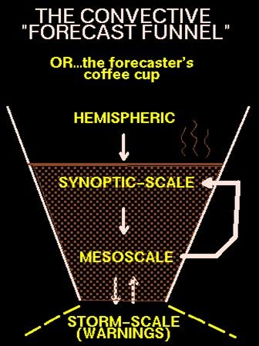
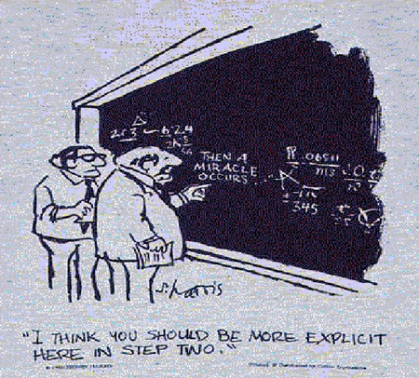
The Link between Observable Scales and
Storm Scales is not necessarily clear…
Notes:
ARL leads or participates in establishing climate quality data and products for upper air measurements thru GRUAN, historical energy balance data from GEWEX, insitu Climate Reference Network data, and using homogenous datasets to examine long term trends.

Slide 12
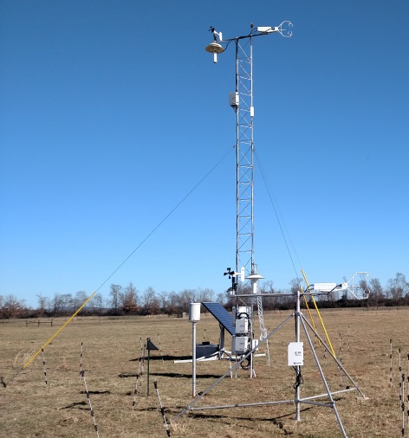
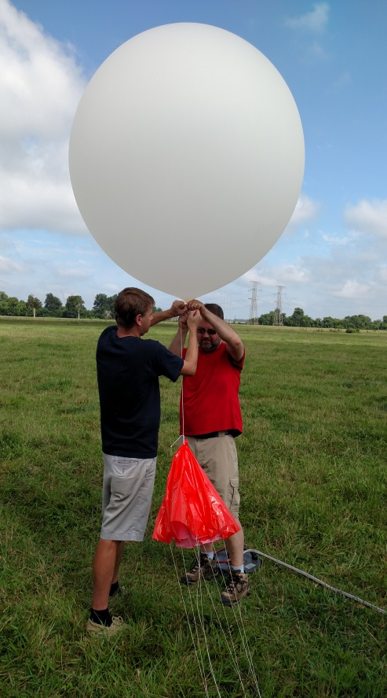
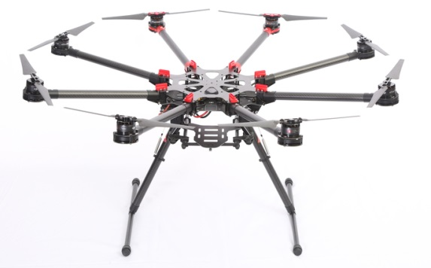
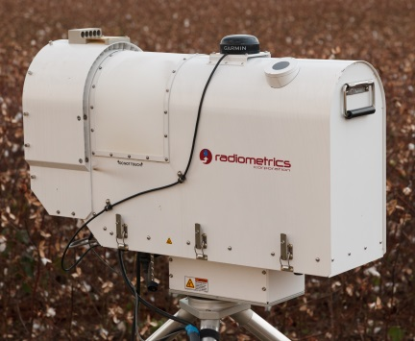
Observation Platforms for Investigating
Convection Initiation and Tornadogenesis
10 m Flux Towers
UAS
Rawinsondes
Wind Lidar
Microwave Radiometer

Slide 13
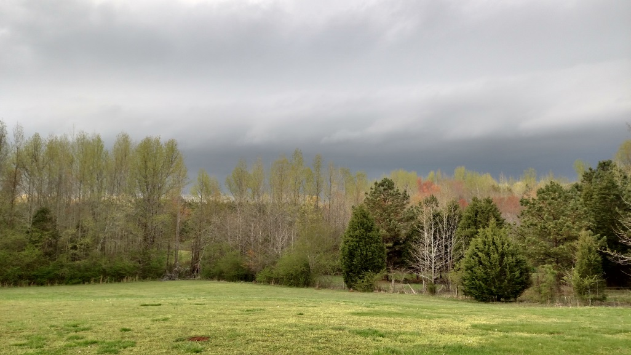
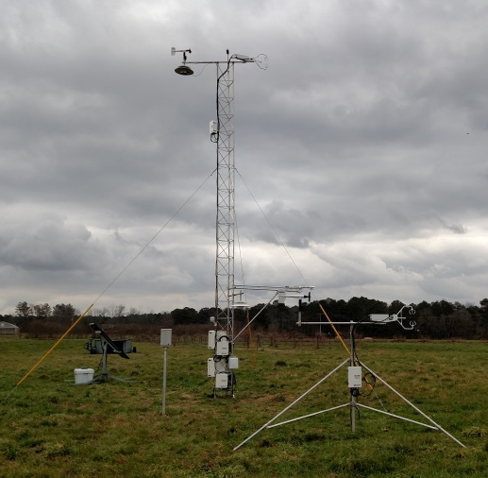
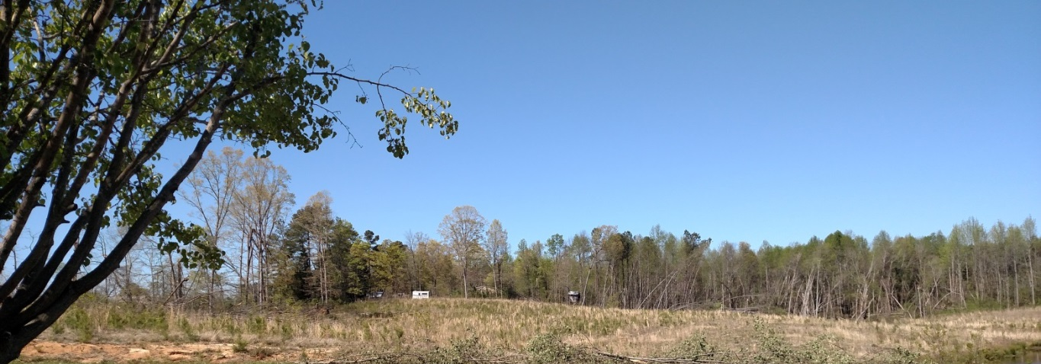
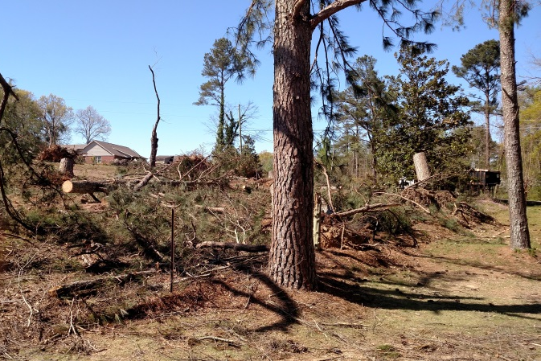
Tornadogenesis
Multiple flux towers and wind LIDAR were installed in northern Alabama in Jan-Feb 2016 to support VORTEX-SE research.
Rawinsondes were released every hour from multiple sites to characterize the rapid destabilization of the boundary layer prior to severe weather development.
Cameras installed on board the sUAS are being used to assist with storm damage surveys.

Slide 14
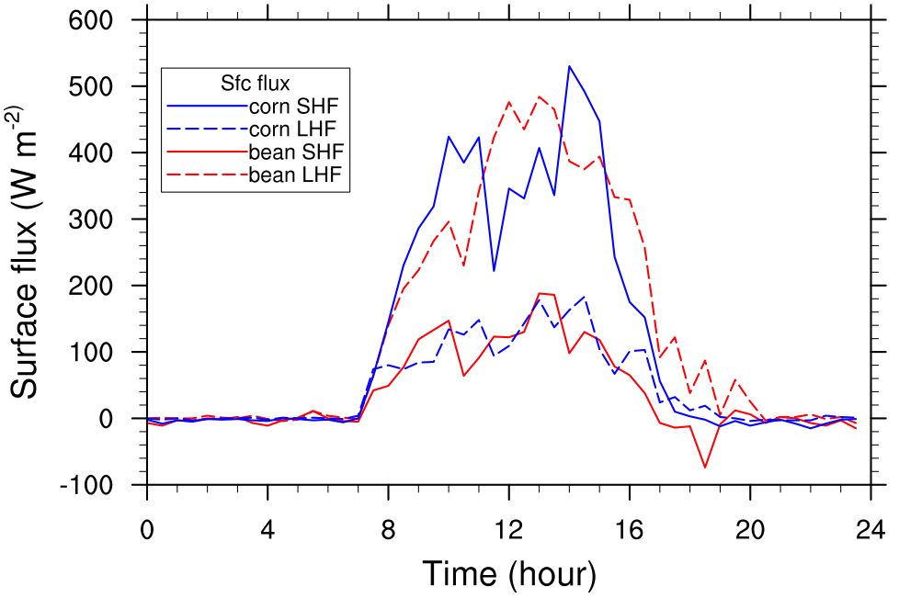
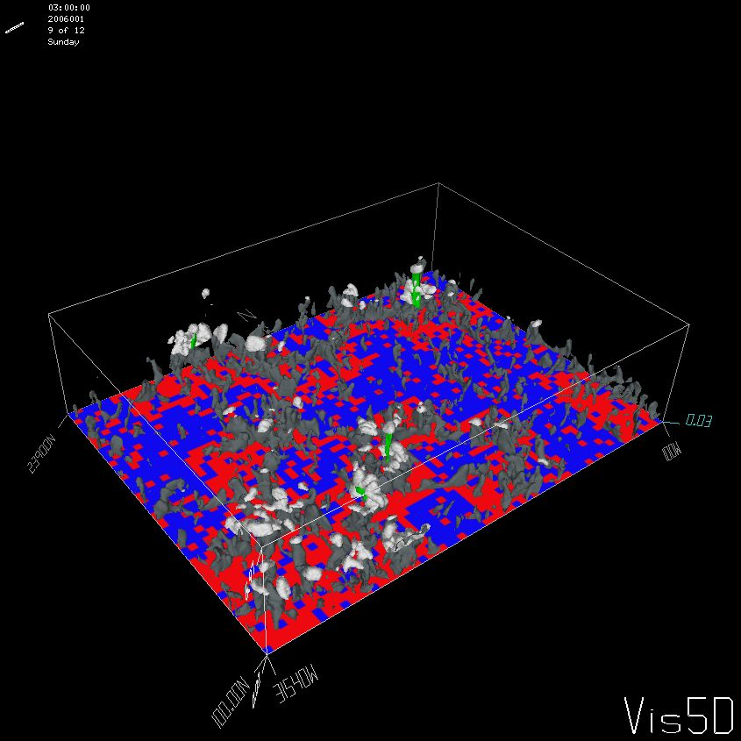
Using observed values for Heat and
Water Vapor to predict small scale
convective initiation
INPUT
OUTPUT

Slide 15
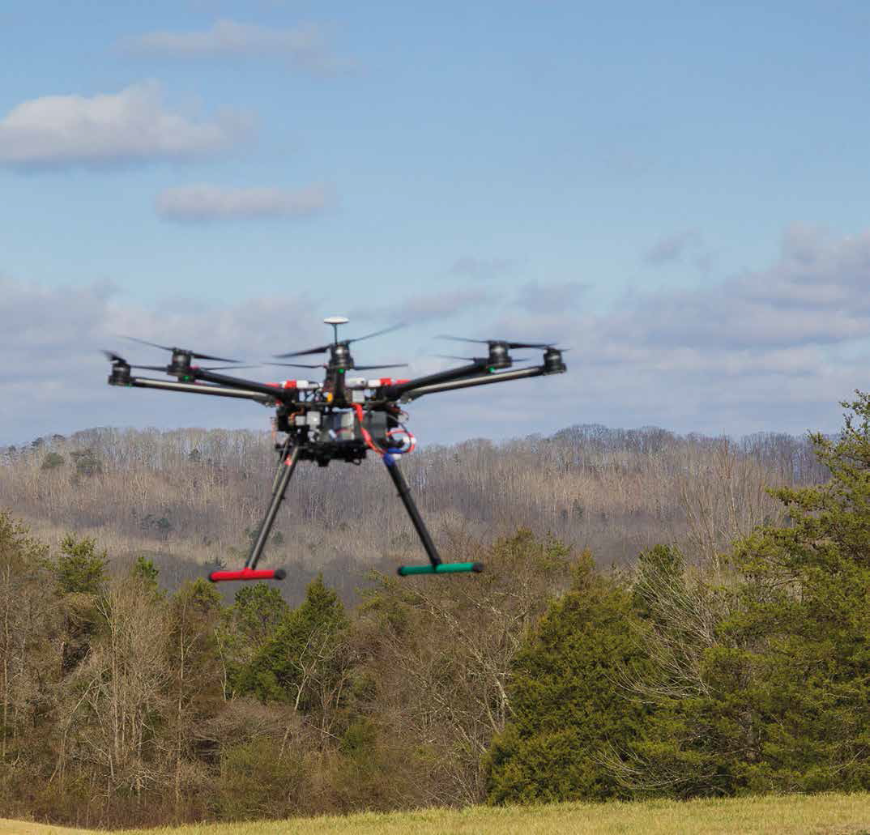
PUSH THE
BOUNDARIES
Air Resources Laboratory
15

Slide 16
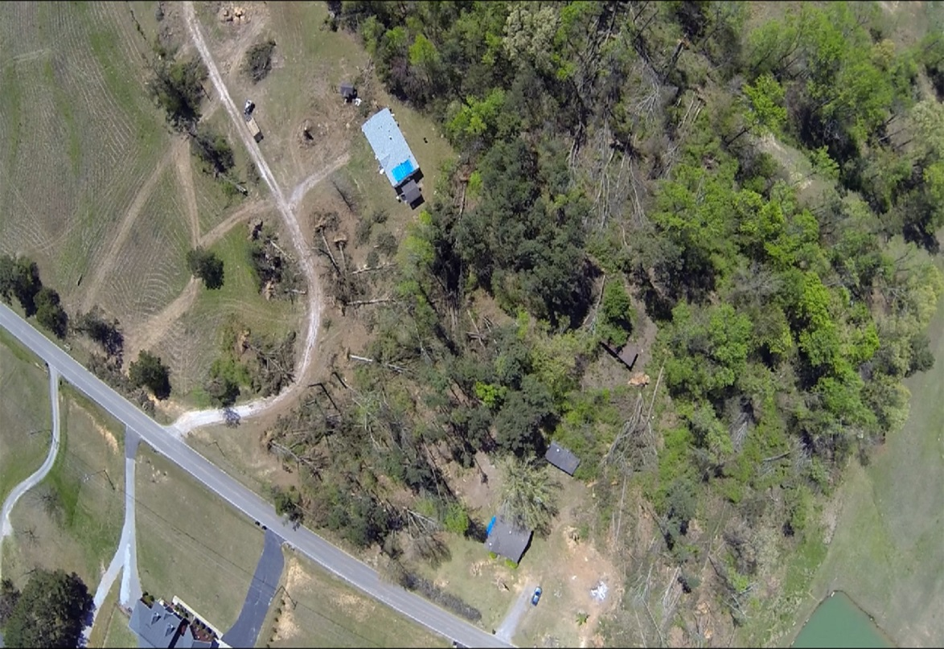
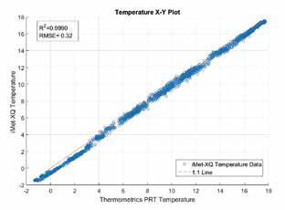
Verification of the Origins of Rotation in Tornadoes EXperiment-Southeast (VORTEX-SE)
Goal: Understand how environmental
factors in the southeastern US affect the formation, intensity, structure and path of tornadoes
A sUAS flown by ARL/ATDD will be used to survey storm damage and provide key atmospheric data that can be used to understand how the land surface may play a role in tornadogenesis.

Slide 17
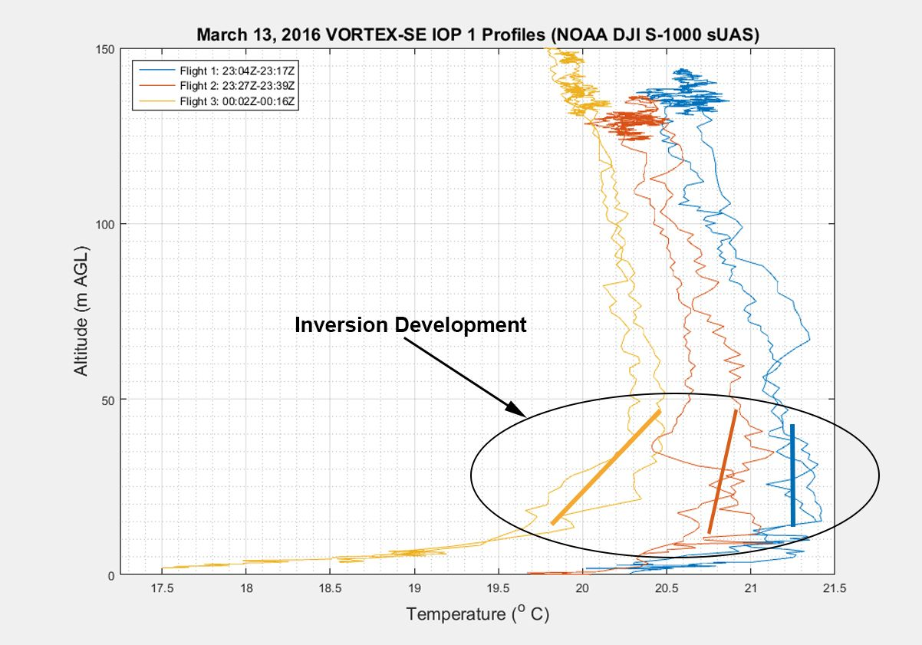

Slide 18
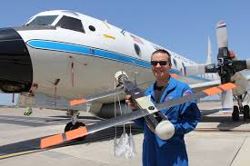
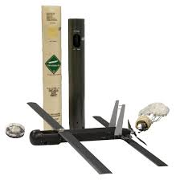
Hurricane Research
ATDD and NOAA’s Atlantic Oceanographic and Meteorological Laboratory are working together to use the Coyote for hurricane tracking and modeling.
The Coyote is a small, expendable Unmanned Aircraft System that can be tube-launched from the ground or in the air.
The team recently completed a successful calibration flight over Avon Park, Florida, USA where a Coyote was launched from a P-3 hurricane hunter aircraft to prepare for deployment during the 2016 storm season.
ATDD will be integrating instrumentation into the Coyote to measure temperature, relative humidity, pressure, and in phase two 3-D winds.

Slide 19
Questions?

